Slide 1
Digital Portfolio
STUDENT NAME : RAHMATHUNNISA A
REGISTER NO AND NMID : 34624U09073 / ASTVU346M24307
DEPARTMENT : BCA
COLLEGE/ UNIVERSITY : MMES WOMEN’S ARTS AND SCIENCE COLLEGE/ HIRUVALLUVAR UNIVERSITY

Slide 2
PROJECT TITLE
SMART DIGITAL PORTFOLIO FOR STUDENTS

Slide 3


AGEND
Problem Statement
Project Overview
End Users
Tools and Technologies
Portfolio design and Layout
Features and Functionality
Results and Screenshots
Conclusion
Github Link
3/21/2024 Annual Review

Slide 4

PROBLEM STATEMENT
Students often struggle to maintain and present their academic achievements, skills, and projects in an organized manner. Traditional resumes lack creativity and do not reflect a student’s complete personality, while existing portfolio solutions are not student-centric.There is a need for a smart digital portfolio system that helps students showcase their achievements, skills, projects, hobbies, and certifications in an interactive and professional way.
Notes:
Students often struggle to maintain and present their academic achievements, skills, and projects in an organized manner. Traditional resumes lack creativity and do not reflect a student’s complete personality, while existing portfolio solutions are not student-centric. There is a need for a smart digital portfolio system that helps students showcase their achievements, skills, projects, hobbies, and certifications in an interactive and professional way.

Slide 5

PROJECT OVERVIEW
The Smart Digital Portfolio is a web-based solution designed to provide students with a personalized, professional, and dynamic portfolio.It enables students to highlight their academic background, technical skills, personal achievements, projects, hobbies, and extracurricular activities in a visually appealing manner.This portfolio can be shared with recruiters, faculty, or peers, making it easier for students to stand out in academics and career opportunities.

Slide 6

WHO ARE THE END USERS?
Students – to create and maintain their portfolios.
Faculty/College – to evaluate student achievements.
Recruiters/Employers – to review student profiles quickly.
Peers/Community – to collaborate and connect.

Slide 7

TOOLS AND TECHNIQUES
Frontend: HTML5, CSS3, JavaScript
Backend (optional for dynamic portfolio): Node.js / PHP / Firebase
Database (optional): MySQL / MongoDB
Design Tools: Canva / Figma for layout design Version Control: GitHub for code hosting and collaboration

Slide 8
POTFOLIO DESIGN AND LAYOUT
Dark & Light Themes for better user experienc.
Sections:
About me
Education & skills & projects & Achievements
Hobbies&interests
Certifications&Awards
Contact&Social media links
8

Slide 9
FEATURES AND FUNCTIONALITY
User-friendly Interface for easy portfolio creationInteractive Resume Download (PDF)Project Showcase with GitHub LinksHobbies & Interests Section (painting, drawing, reading, writing, etc.)Customizable ThemesSecure Login (if dynamic)Easy Sharing via URL/QR Code

Slide 10
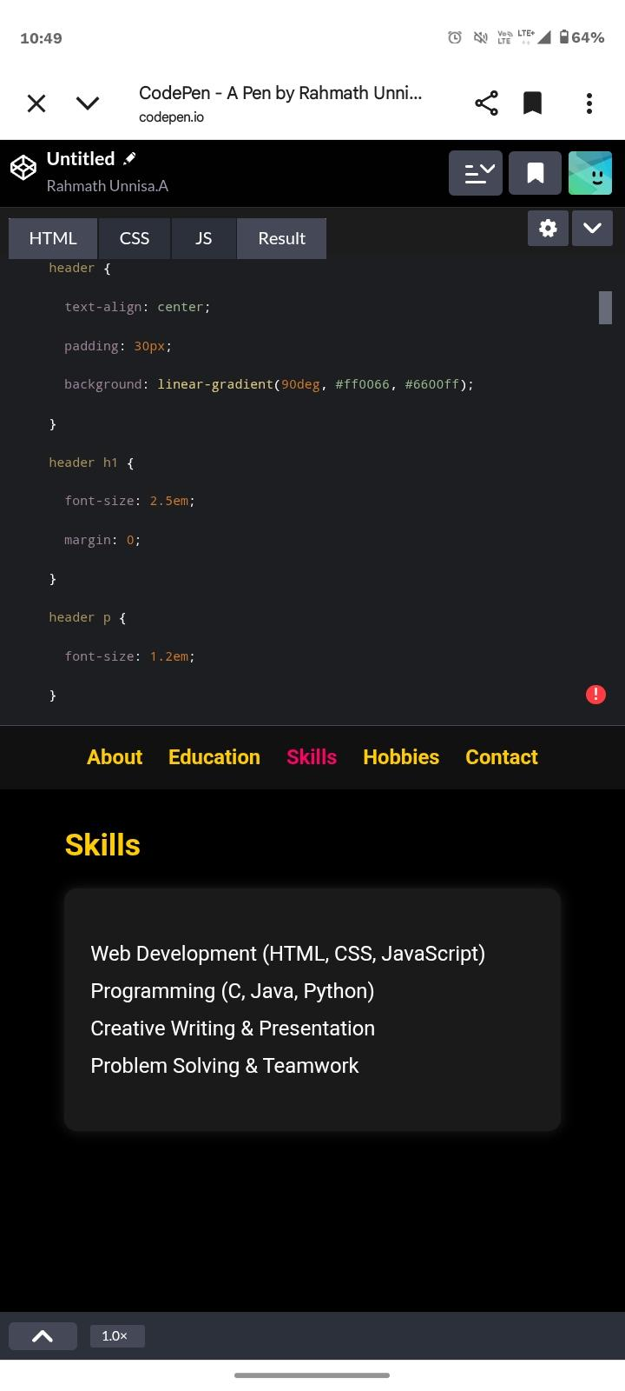
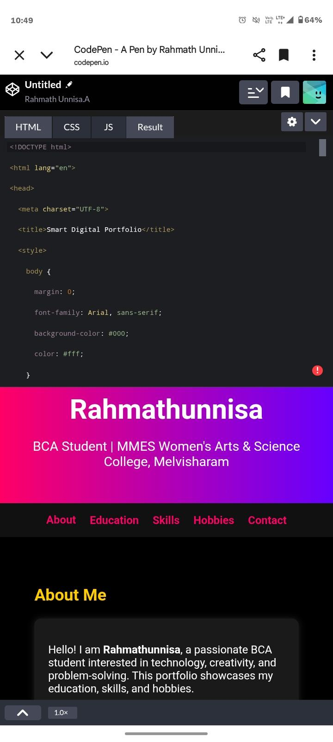
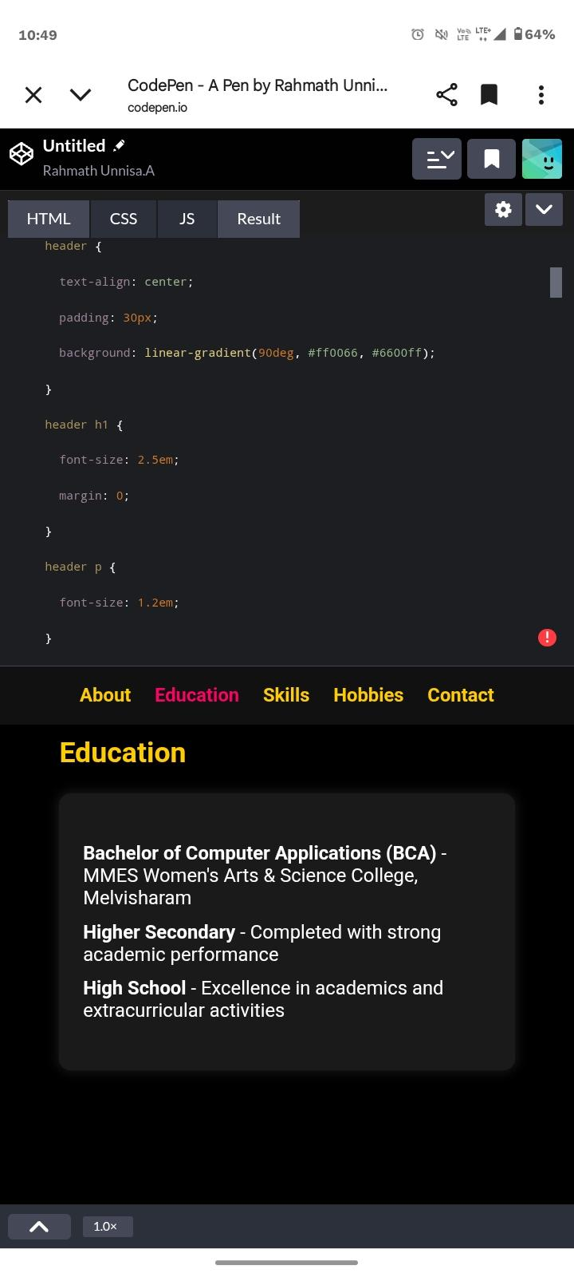

RESULTS AND SCREENSHOTS
3/21/2024 Annual Review
10

Slide 11
CONCLUSION
The Smart Digital Portfolio for Students provides a modern way to present academic and personal achievements.It helps students stand out in academic evaluations, internships, and job placements by offering a professional, dynamic, and creative self-representation tool.
GitHub link :
https://rahmathunnisa123.github.io/My-portfolio-/
11

